Slide 1
2017. 8. 4

Slide 2
인공지능

Slide 3
AI
사람이 일일이 가르쳐주지 않아도 스스로 학습하여 성능이 개선
자동화가 가능하다는 장점
이미 성능이 우수하다
질병예측, 이상치 검출, 인식, 인지
아직 본격적인 AI 시대는 시작하지 않았다
거의 모든 분야에 영향을 줄 것
실체와 한계를 아직 잘 모른다

Slide 4
AI가 성과를 내는 영역
Perception
Cognition

Slide 5
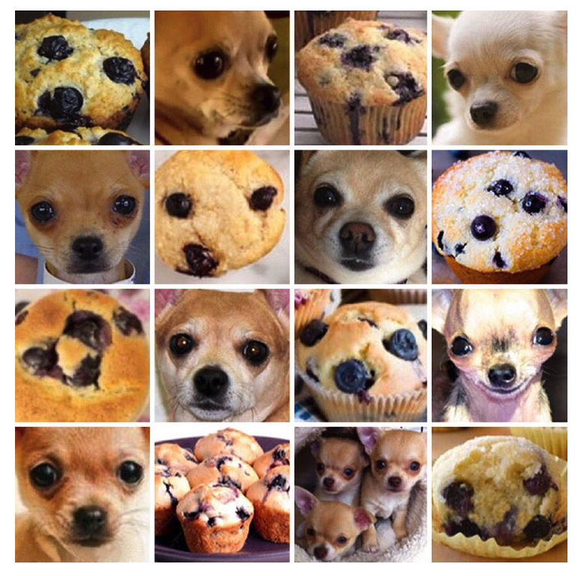
Perception

Slide 6
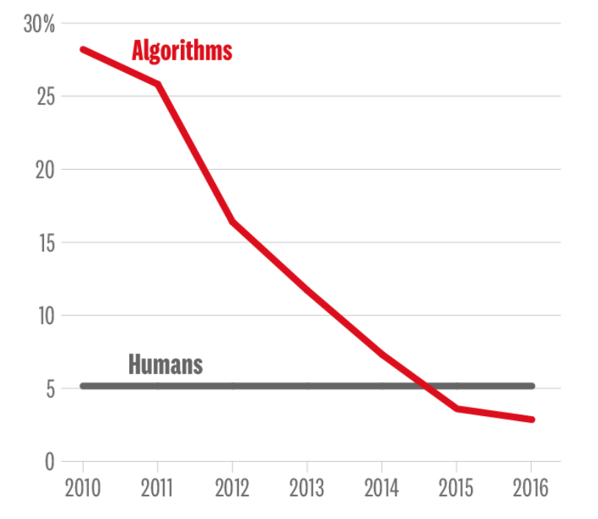
이미지 인식률

Slide 7
Cognition
알파고

Slide 8
데이터 분석의 핵심 요소
분석목적
데이터
분석도구

Slide 9
스마트시티

Slide 10
과학기술전략회의 (2016. 8)
상호 시너지를 낼 수 있는 물-에너지, 교통-안전 등 개별 인프라 분야를 통합․연계할 수 있는 스마트시티 기술개발 및 실증모델 구축(‘20)
건물-에너지 관리(마이크로그리드) 분야, 물-에너지 관리 분야, 교통-재난안전-시설물관리 분야 등 시스템 연계를 통한 도시관리 효율 향상
도시내 상황을 실시간 습득․분석할 수 있도록 통합 플랫폼을 구축, 각종 도시문제에 대한 의사결정 지원 시스템 개발(‘21)로 공공서비스 質 향상
도시관리 빅데이터를 통합 관리하고, 이를 민간에도 개방하여 일반시민, 기업 등이 참여하는 고부가가치 新산업 생태계 조성
개발된 기술을 도시유형별로 차별화된 실증도시에 구현(‘20)하고, 해외국가 수준별 맞춤형 수출모델*도 제시하여 스마트시티 해외진출 확대
인프라 중심 신도시 모델, 서비스솔루션 중심 기존도시 모델 / 해외국가 맞춤형 모델

Slide 11
자율주행차
‘자율주행자동차 국가전략 프로젝트’를 통한 8대 핵심부품, 6대 융합 신기술개발로 핵심부품 국산화 및 미래 자율주행 융합기술을 선도
8대 핵심부품(‘19) → 레벨3 자율주행 기술(’21) → 무인셔틀 등 융합서비스 실증(‘24)
(핵심부품) 자율주행차의 필수 구성요소(센서, 통신, 제어 등) 핵심부품을 대기업·부품업체의 협력 기술개발(‘19)로 가격·성능 경쟁력을 확보하고,
(6대 융합신기술) AI 기반 주변상황 인식기술, 교통환경 인지·분석·제어 기술, 통신 암호화 등이 융합된 자동차·ICT·인프라 연계형 신산업을 창출
인공지능·통신·인프라 기술 등을 연계융합(‘24)하여 제한된 조건의 자동제어 자율주행기술(차선·차간거리 유지, 차선변경, 교차로·분기로 주행지원, 교통 혼잡도로 우회주행 등) 확보
글로벌 수준의 실증환경 조성 및 융합 생태계 조성 등을 통한 자율주행차 상용화 기반 구축
(실증환경) 대구 규제프리존과 연계한 핵심부품 자율주행 실도로 실증(’20)과 ‘Negative’ 방식의 규제완화로 자율주행 상용화에 선제적 대응
- (융합생태계) “자동차 융합 얼라이언스”를 통한 자동차-ICT간 협업 활성화와 R&D, 실증사업을 매개로 한 산업간 융합의 활성화를 지원

Slide 12
구글 Auto Machine Learning
신경망이 다른 신경망을 설계
인간은 아이디어만 내면 된다

Slide 13
Nest
smart thermostats, smoke and carbon monoxide detectors and most recently security cameras
operating system for the home
and electric savings 10%-12% of heating usage, 15% of cooling usage
가정에서 에너지 제어에 있어 편안함과 편리함을 제공했다
https://nest.com/downloads/press/documents/energy-savings-white-paper.pdf

Slide 14
Hands-on

Slide 15
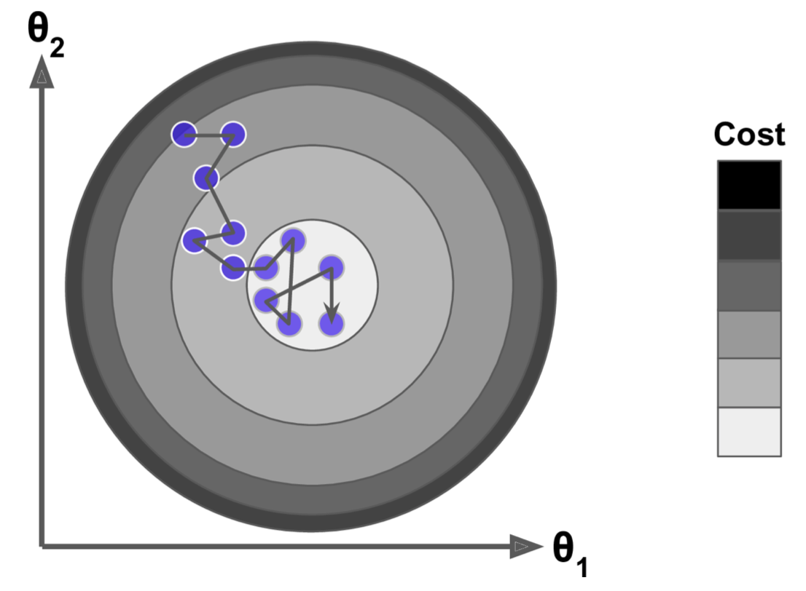
Stochastic Gradient Descent
In Batch Gradient Descent: uses the whole training set to compute the gradients at every step
makes it very slow
In Stochastic Gradient Descent: picks a random instance in the training set at every step
fast !
can actually help the algorithm jump out of local minima

Slide 16
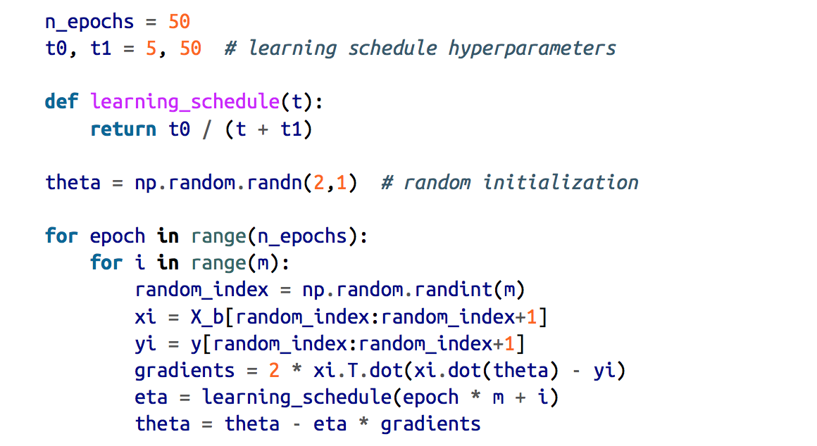
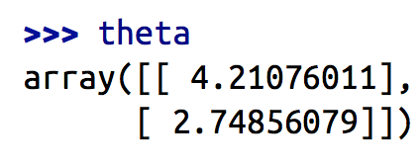
simulated annealing
gradually reduce the learning rate
Via learning schedule

Slide 17
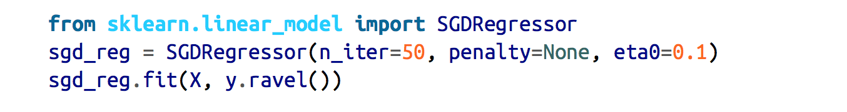
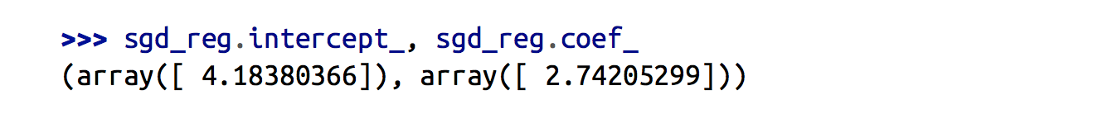
SGDRegressor
Linear Regression using SGD
optimizing the squared error cost function
does not use any regularization (penalty=None)

Slide 18
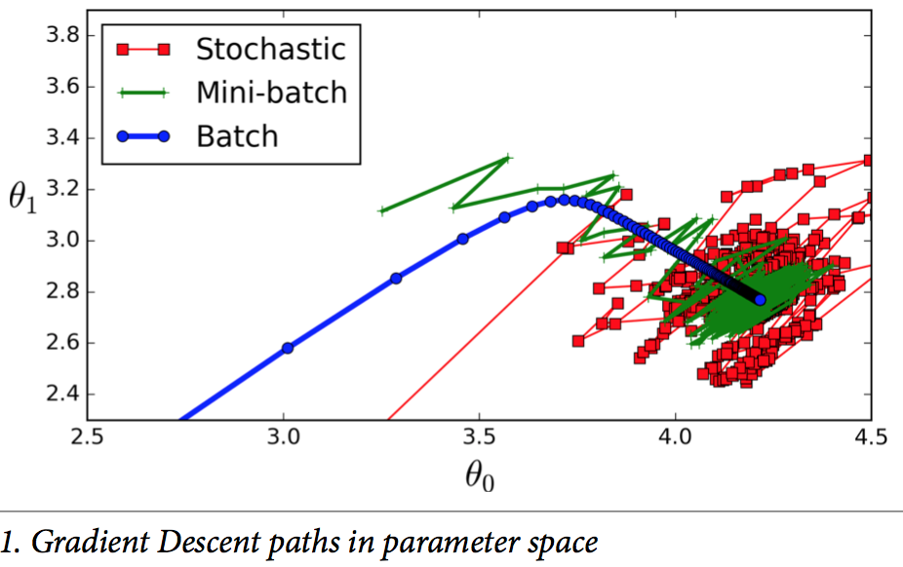
Mini-batch Gradient Descent
computes the gradients on small random sets of instances
performance boost from hardware optimization of matrix operations, especially when using GPUs

Slide 19
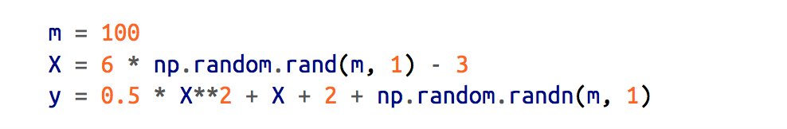
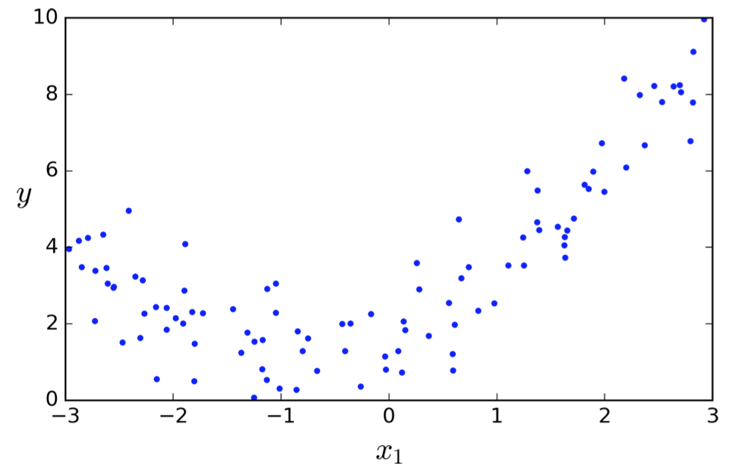
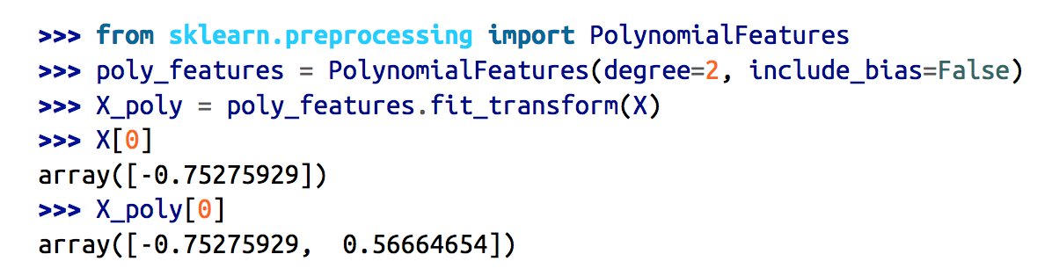
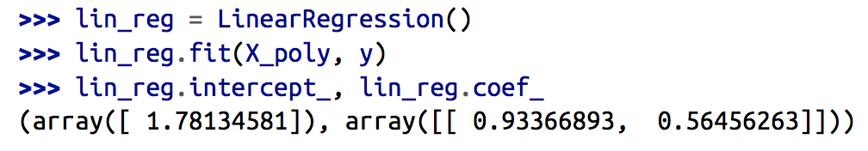
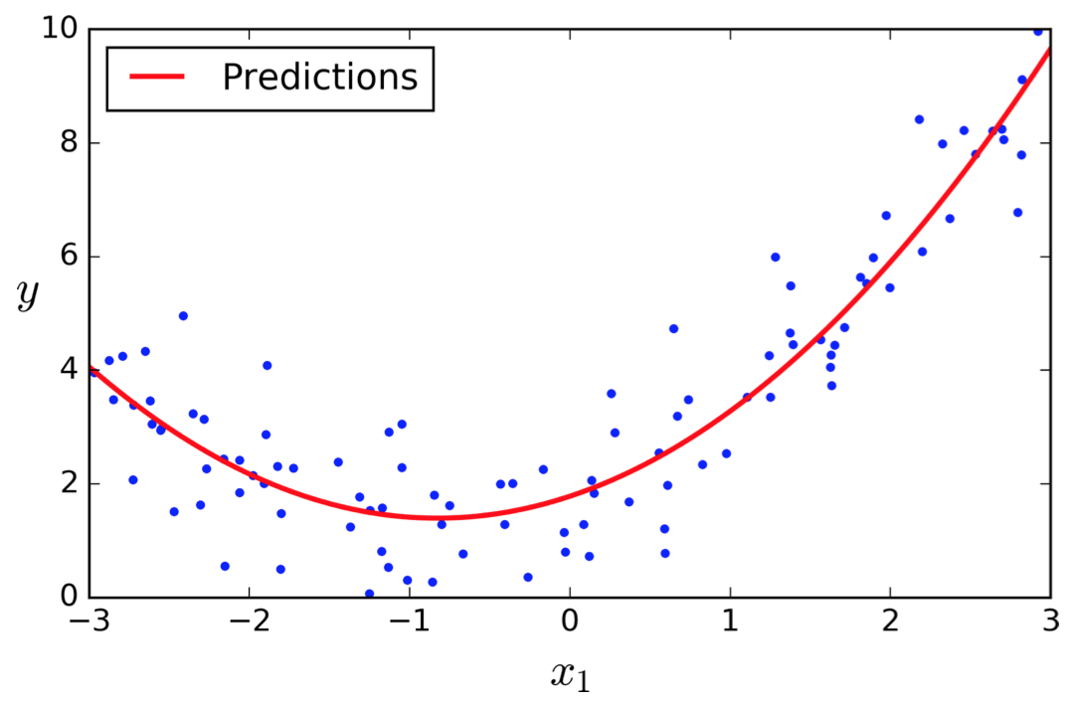
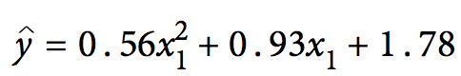
Polynomial Regression
add powers of each feature as new features

Slide 20
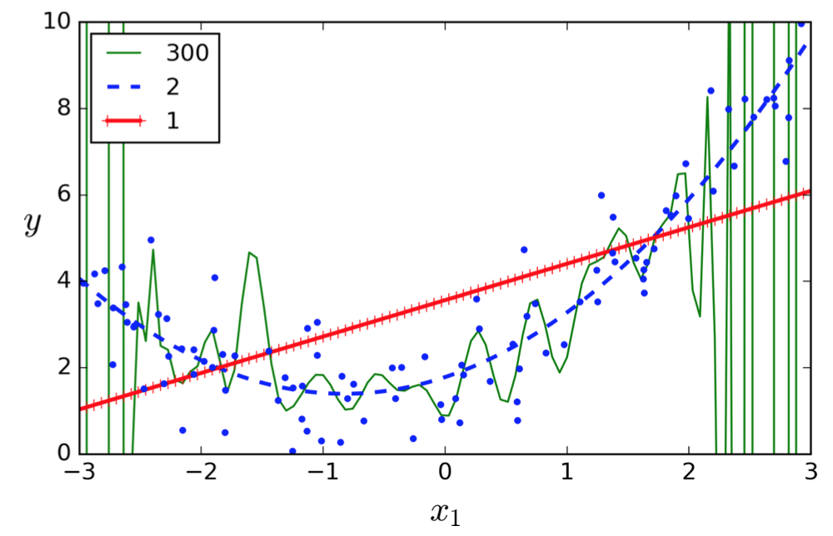
overfitting or underfitting

Slide 21
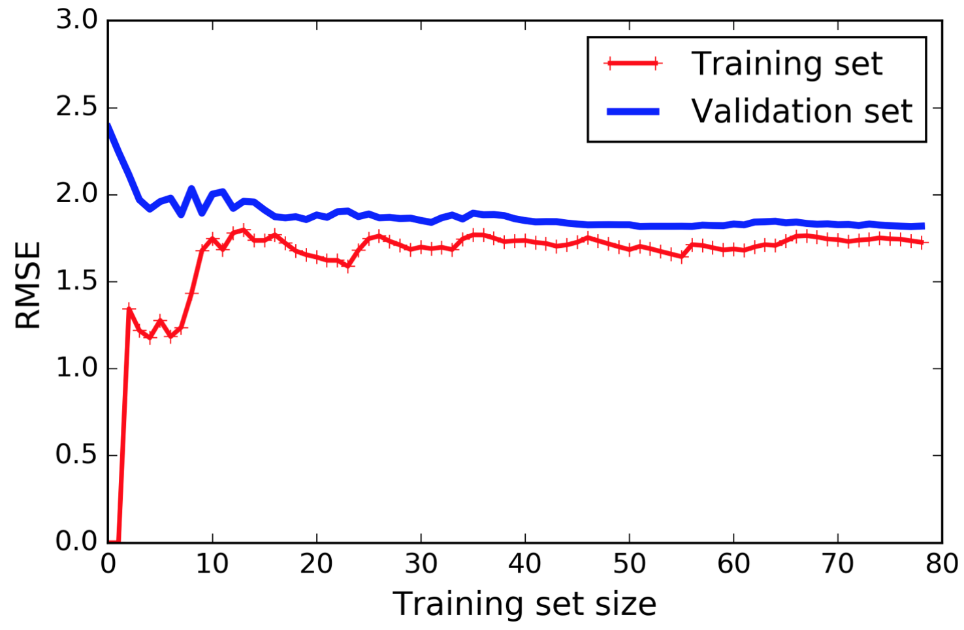
learning curves (underfitting case)
plots of the model’s performance on the training set and the validation set as a function of the training set size
If your model is underfitting the training data, adding more training examples will not help. (linear regression)
You need to use a more complex model or come up with better features.

Slide 22
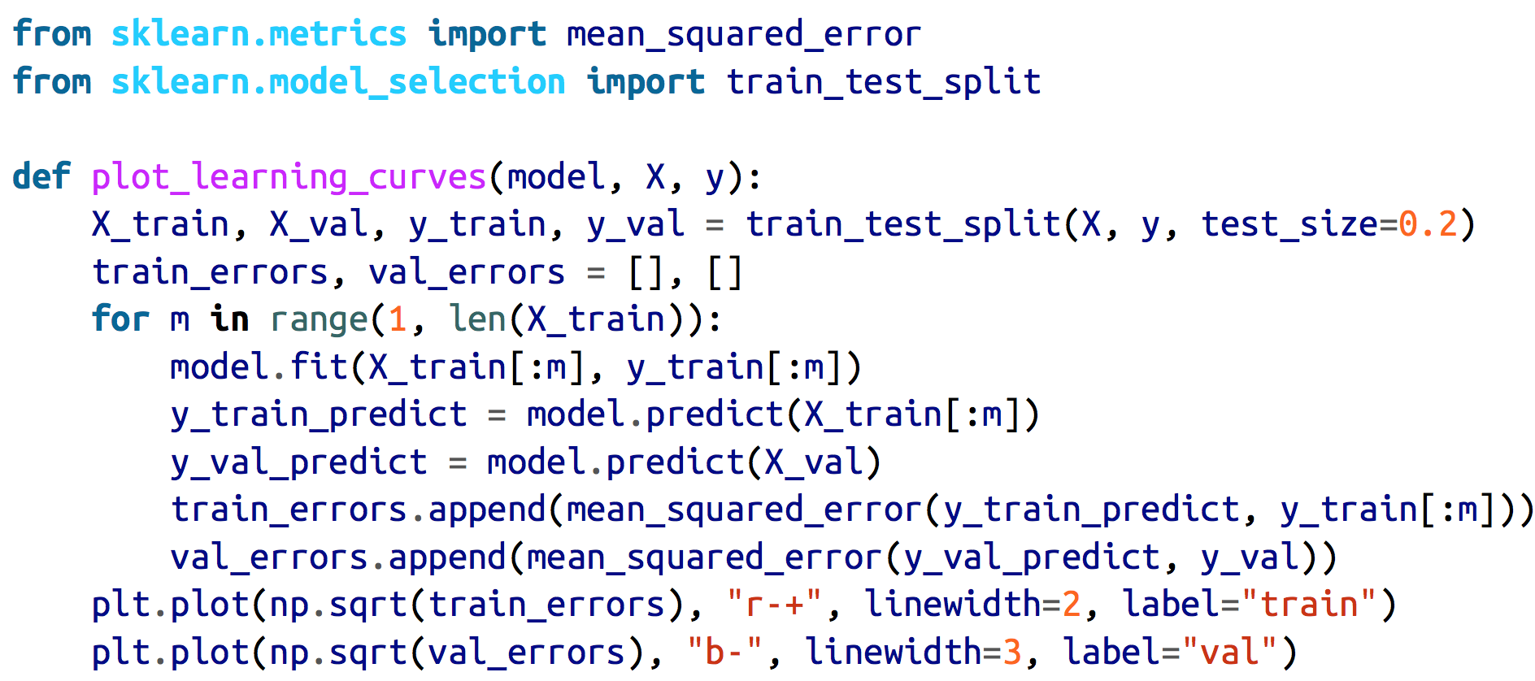
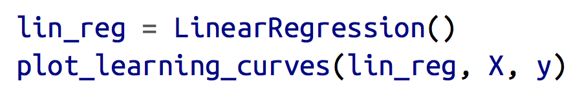
code

Slide 23
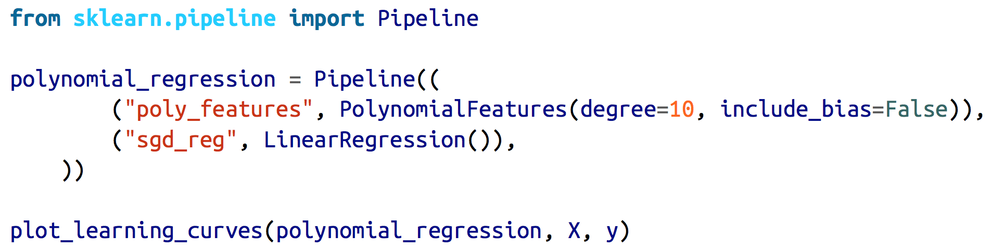
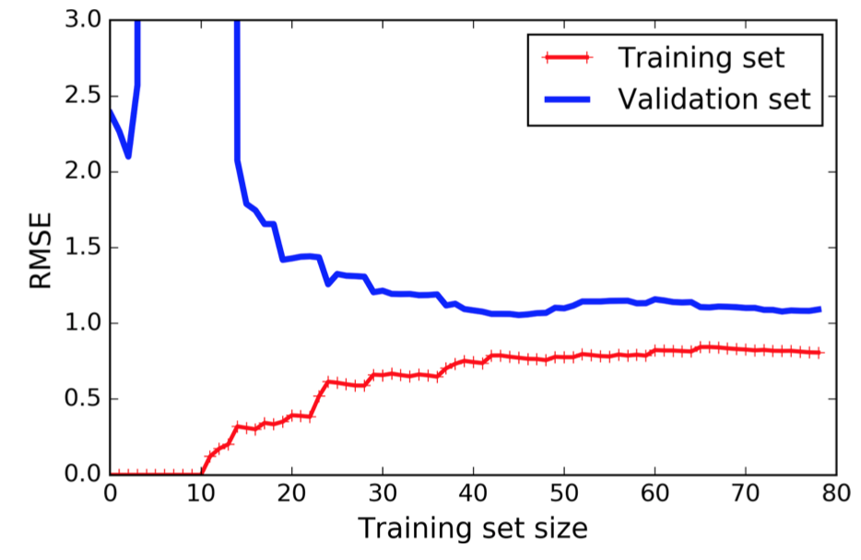
10th-degree polynomial model(overfitting)
Use much data!

Slide 24
The Bias/Variance Tradeoff
A model’s generalization error is composed of:
Bias
due to wrong assumptions
A high-bias model is most likely to underfit the training data
Variance
due to the model’s excessive sensitivity to small variations in the training data
such as a high-degree pol‐ ynomial model
overfit the training data
Irreducible error
due to the noisiness of the data itself
clean up the data
Increasing a model’s complexity will typically increase its variance and reduce its bias
reducing a model’s complexity increases its bias and reduces its variance

Slide 25
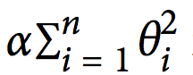
Regularized Linear Models
a good way to reduce overfitting
constrain it (i.e., fewer degrees of freedom)
Ridge Regression
a regularization term is added to the cost function:
keep the model weights as small as possible
only be added to the cost function during training
hyperparameter α controls how much you want to regularize the model
scale the data before performing Ridge Regression

Slide 26
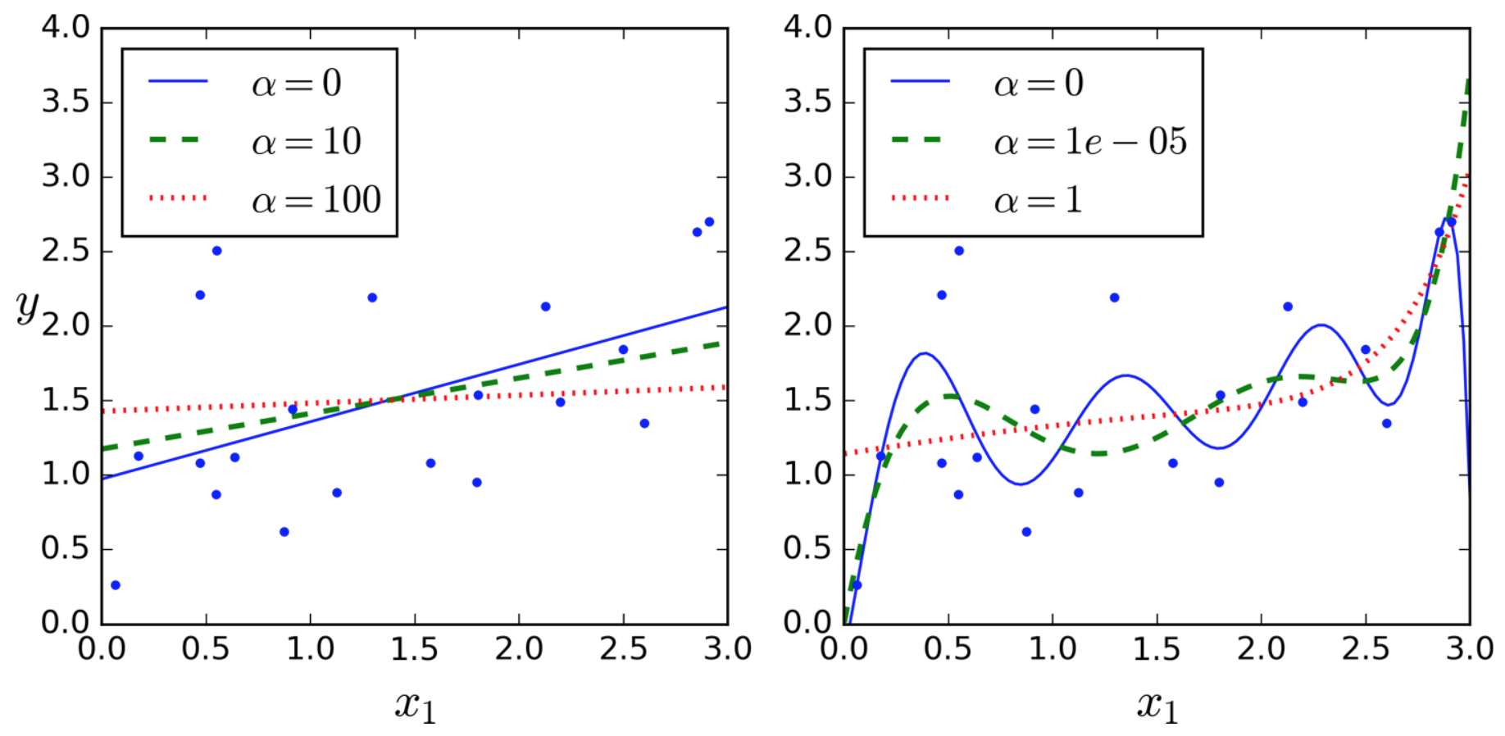

Slide 27
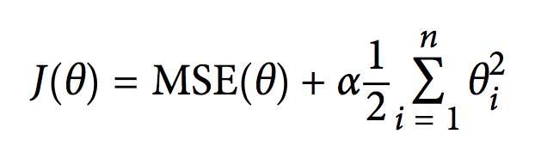
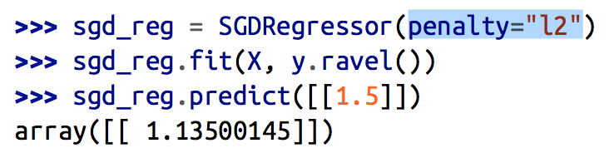
Ridge Regression (Stochastic Gradient Descent)
i > 0
L2 : add a regularization term

Slide 28
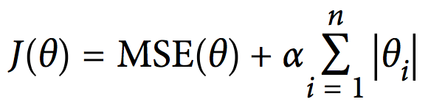
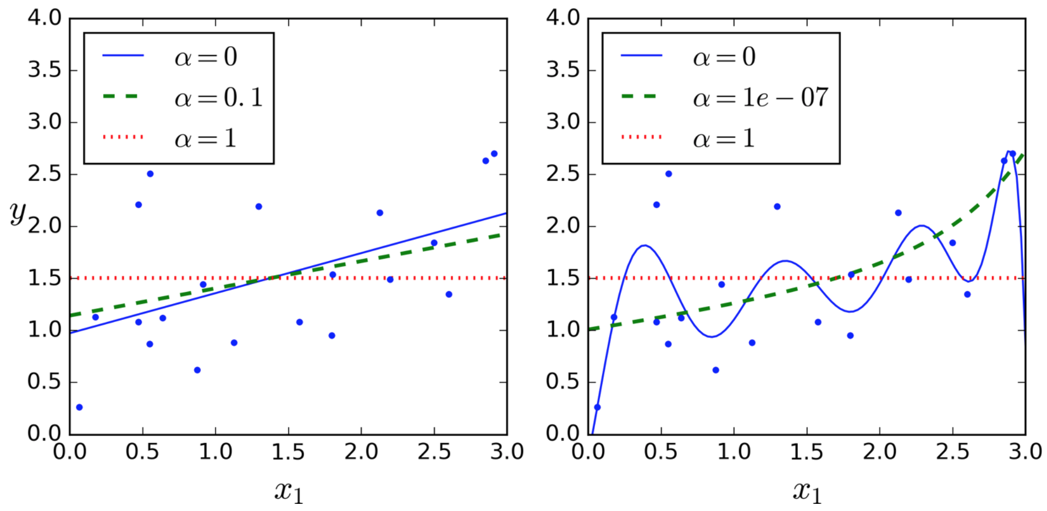
Lasso Regression
Least Absolute Shrinkage and Selection Operator Regression

Slide 29
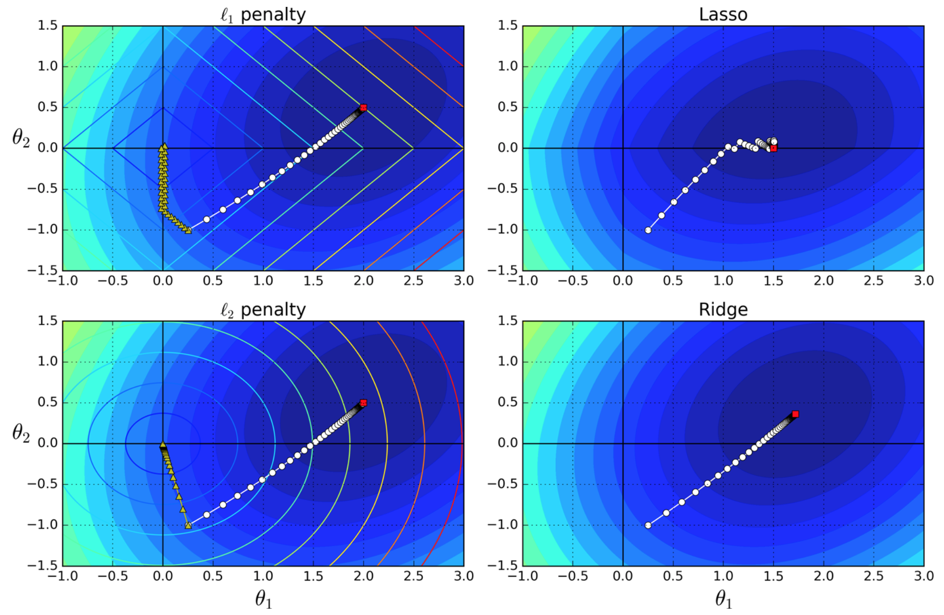
Lasso Regression
automatically performs feature selection
outputs a sparse model (i.e., with few nonzero feature weights)

Slide 30
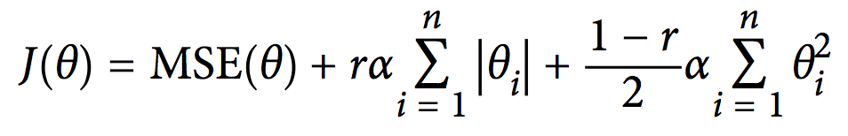
Elastic Net
Ridge is a good default
if you suspect that only a few features are actually useful, you should prefer Lasso or Elastic Net*
tend to reduce the useless features’ weights down to zero

Slide 31
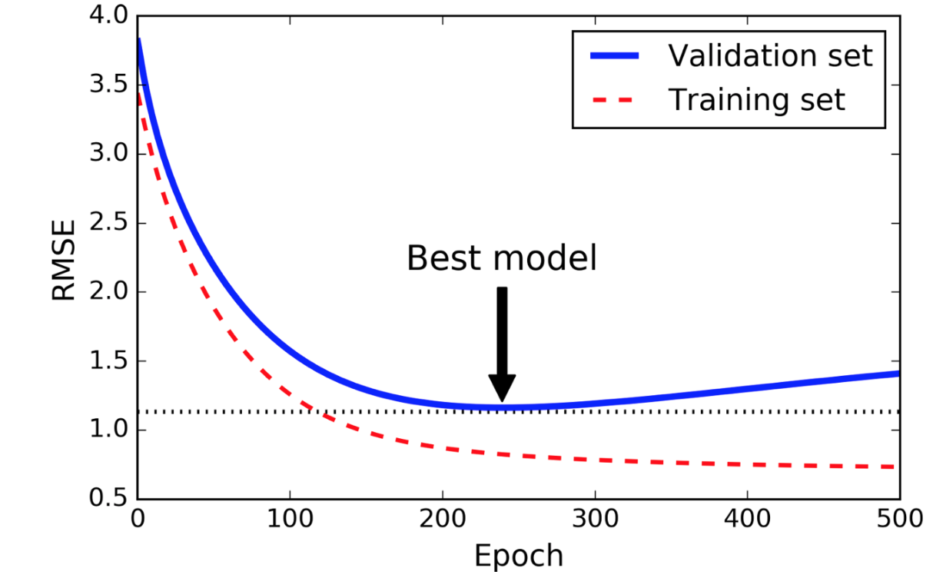
Early Stopping
stop training as soon as the validation error reaches a minimum
Before start to overfit the training data

Slide 32
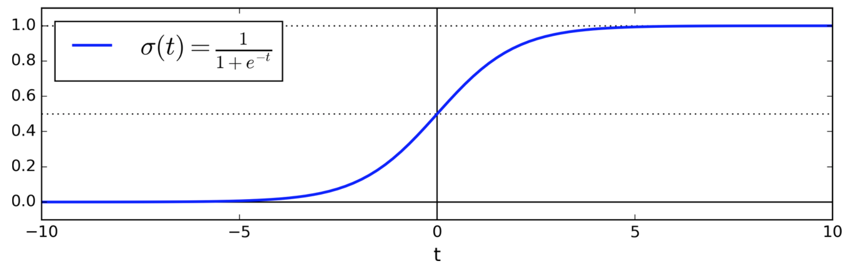
Logistic Regression
a binary classifier
computes a weighted sum of the input features
But it outputs the logistic of this result
The logistic—also called the logit, noted σ(·)—is a sigmoid function (i.e., S-shaped) that outputs a number between 0 and 1

Slide 33
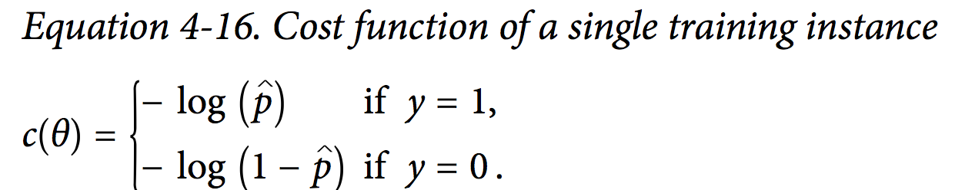
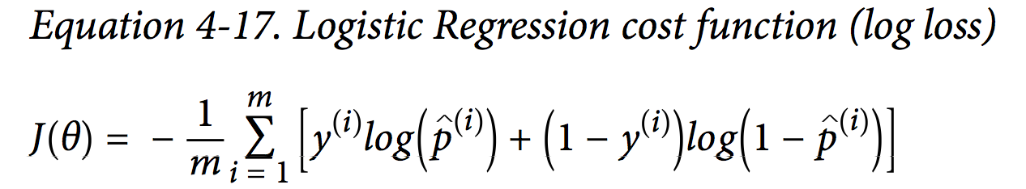
Training and Cost Function
Train to set the parameter vector θ so that the model estimates high probabilities for positive instances (y = 1) and low probabilities for negative instances (y = 0).
there is no known closed-form solution, but the cost function is convex
Gradient Descent can be used!

Slide 34
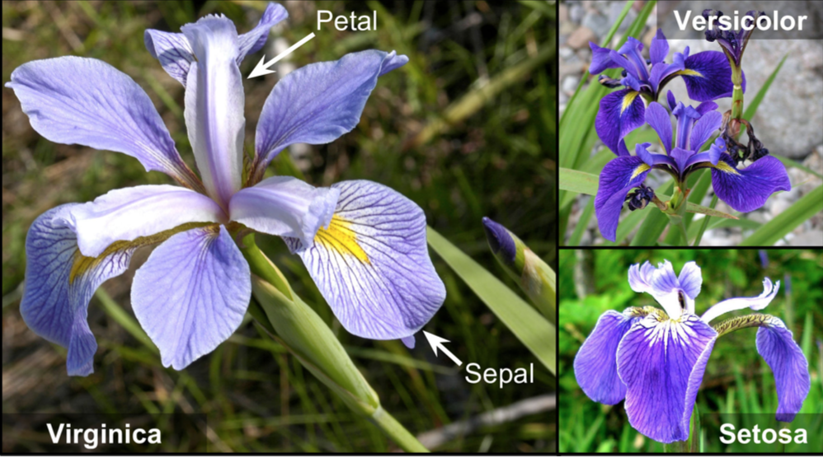
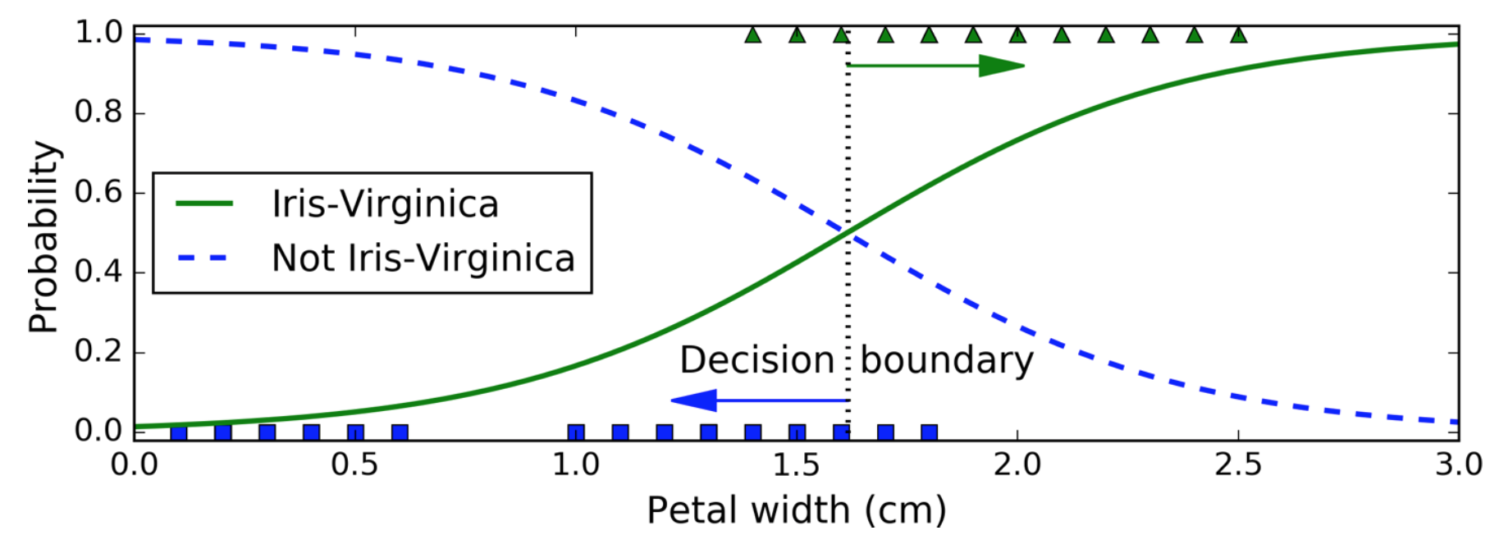
Decision Boundaries

Slide 35
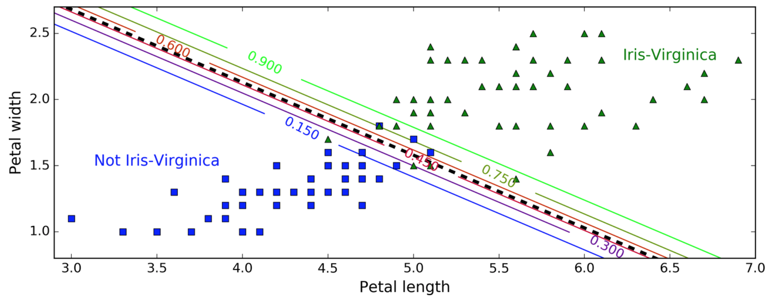
Decision Boundaries (with two features)

Slide 36
Just like the other linear models, Logistic Regression models can be regularized using l1 or l2 penalties. Scitkit-Learn actually adds an l2 penalty by default.

Slide 37
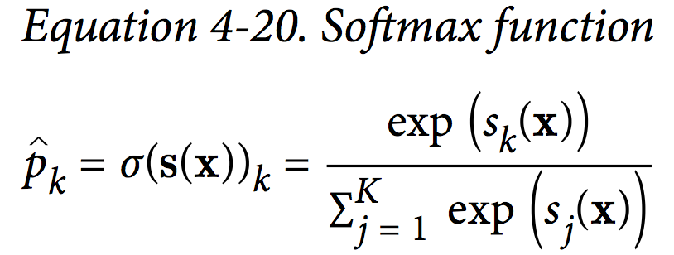
Softmax Regression
Logistic Regression model generalized to support multiple classes
Multinomial Logistic Regression
computes score for each class k, then estimates the probability of each class by applying the softmax function (normalized exponential)
the estimated probability that the instance x belongs to class k
not multioutput !
You cannot use it to recognize multiple people in one picture

Slide 38
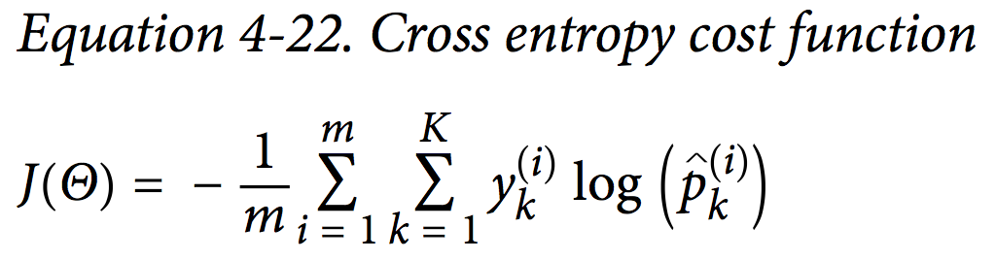
Training with Cross entropy

Slide 39
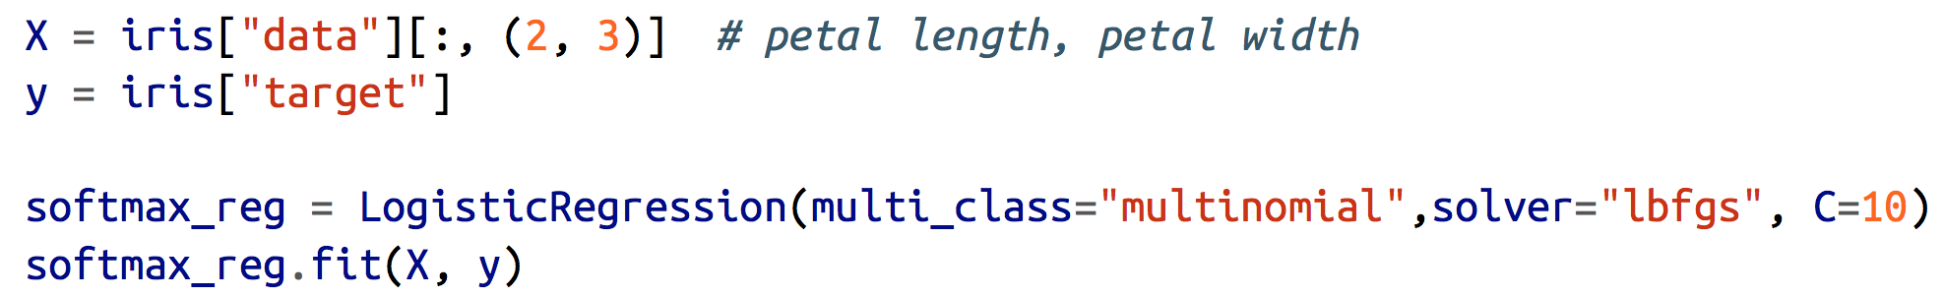
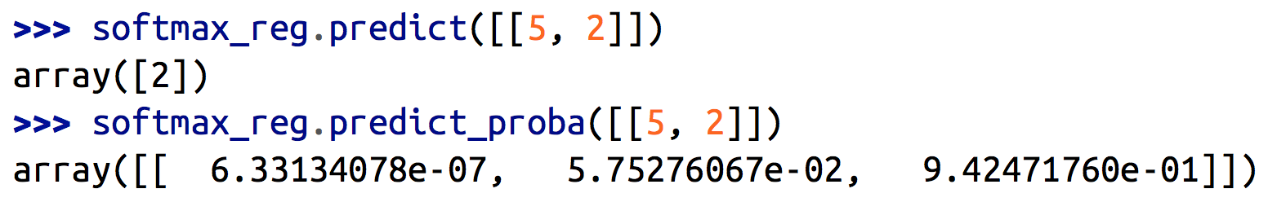
use Softmax Regression to classify the iris flowers into all three classes
C: hyperparameter (The higher the value of C, the less the regularized)
an iris with 5 cm long and 2 cm wide petals -> Iris-Virginica (class 2) with 94.2% probability (or Iris-Versicolor with 5.8% probability)

Slide 40
Exersize
1. What Linear Regression training algorithm can you use if you have a training set with millions of features?
2. Suppose the features in your training set have very different scales. What algo‐ rithms might suffer from this, and how? What can you do about it?
3.Can Gradient Descent get stuck in a local minimum when training a Logistic Regression model?
4.Do all Gradient Descent algorithms lead to the same model provided you let them run long enough?
5.Suppose you use Batch Gradient Descent and you plot the validation error at every epoch. If you notice that the validation error consistently goes up, what is likely going on? How can you fix this?
6.Is it a good idea to stop Mini-batch Gradient Descent immediately when the validation error goes up?
7.Which Gradient Descent algorithm (among those we discussed) will reach the vicinity of the optimal solution the fastest? Which will actually converge? How can you make the others converge as well?

Slide 41
8.Suppose you are using Polynomial Regression. You plot the learning curves and you notice that there is a large gap between the training error and the validation error. What is happening? What are three ways to solve this?
9.Suppose you are using Ridge Regression and you notice that the training error and the validation error are almost equal and fairly high. Would you say that the model suffers from high bias or high variance? Should you increase the regulari‐ zation hyperparameter α or reduce it?
10.Why would you want to use:
Ridge Regression instead of Linear Regression?
Lasso instead of Ridge Regression?
Elastic Net instead of Lasso?
11.Suppose you want to classify pictures as outdoor/indoor and daytime/nighttime. Should you implement two Logistic Regression classifiers or one Softmax Regression classifier?
12.Implement Batch Gradient Descent with early stopping for Softmax Regression (without using Scikit-Learn).

Slide 42
Answer
1.If you have a training set with millions of features you can use Stochastic Gradient Descent or Mini-batch Gradient Descent, and perhaps Batch Gradient Descent if the training set fits in memory. But you cannot use the Normal Equation because the computational complexity grows quickly (more than quadratically) with the number of features.
2.If the features in your training set have very different scales, the cost function will have the shape of an elongated bowl, so the Gradient Descent algorithms will take a long time to converge. To solve this you should scale the data before training the model. Note that the Normal Equation will work just fine without scaling.
3.Gradient Descent cannot get stuck in a local minimum when training a Logistic Regression model because the cost function is convex.
4.If the optimization problem is convex (such as Linear Regression or Logistic Regression), and assuming the learning rate is not too high, then all Gradient Descent algorithms will approach the global optimum and end up producing fairly similar models. However, unless you gradually reduce the learning rate, Stochastic GD and Mini-batch GD will never truly converge; instead, they will keep jumping back and forth around the global optimum. This means that even if you let them run for a very long time, these Gradient Descent algorithms will produce slightly different models.

Slide 43
5.If the validation error consistently goes up after every epoch, then one possibility is that the learning rate is too high and the algorithm is diverging. If the training error also goes up, then this is clearly the problem and you should reduce the learning rate. However, if the training error is not going up, then your model is overfitting the training set and you should stop training.
6.Due to their random nature, neither Stochastic Gradient Descent nor Mini-batch Gradient Descent is guaranteed to make progress at every single training iteration. So if you immediately stop training when the validation error goes up, you may stop much too early, before the optimum is reached. A better option is to save the model at regular intervals, and when it has not improved for a long time (meaning it will probably never beat the record), you can revert to the best saved model.
7.Stochastic Gradient Descent has the fastest training iteration since it considers only one training instance at a time, so it is generally the first to reach the vicinity of the global optimum (or Mini-batch GD with a very small mini-batch size). However, only Batch Gradient Descent will actually converge, given enough training time. As mentioned, Stochastic GD and Mini-batch GD will bounce around the optimum, unless you gradually reduce the learning rate.

Slide 44
8.If the validation error is much higher than the training error, this is likely because your model is overfitting the training set. One way to try to fix this is to reduce the polynomial degree: a model with fewer degrees of freedom is less likely to overfit. Another thing you can try is to regularize the model—for example, by adding an l2 penalty (Ridge) or an l1 penalty (Lasso) to the cost function. This will also reduce the degrees of freedom of the model. Lastly, you can try to increase the size of the training set.
9.If both the training error and the validation error are almost equal and fairly high, the model is likely underfitting the training set, which means it has a high bias. You should try reducing the regularization hyperparameter α.
10.Let’s see:
A model with some regularization typically performs better than a model without any regularization, so you should generally prefer Ridge Regression over plain Linear Regression.2
Lasso Regression uses an l1 penalty, which tends to push the weights down to exactly zero. This leads to sparse models, where all weights are zero except for

Slide 45
the most important weights. This is a way to perform feature selection auto‐ matically, which is good if you suspect that only a few features actually matter. When you are not sure, you should prefer Ridge Regression.
• Elastic Net is generally preferred over Lasso since Lasso may behave erratically in some cases (when several features are strongly correlated or when there are more features than training instances). However, it does add an extra hyper‐ parameter to tune. If you just want Lasso without the erratic behavior, you can just use Elastic Net with an l1_ratio close to 1.
11.If you want to classify pictures as outdoor/indoor and daytime/nighttime, since these are not exclusive classes (i.e., all four combinations are possible) you should train two Logistic Regression classifiers.
12.See the Jupyter notebooks available at https://github.com/ageron/handson-ml.

Slide 46
Support Vector Machines
Used for linear or nonlinear classification, regression, and even outlier detection
well suited for classification of complex but small- or medium-sized datasets

Slide 47
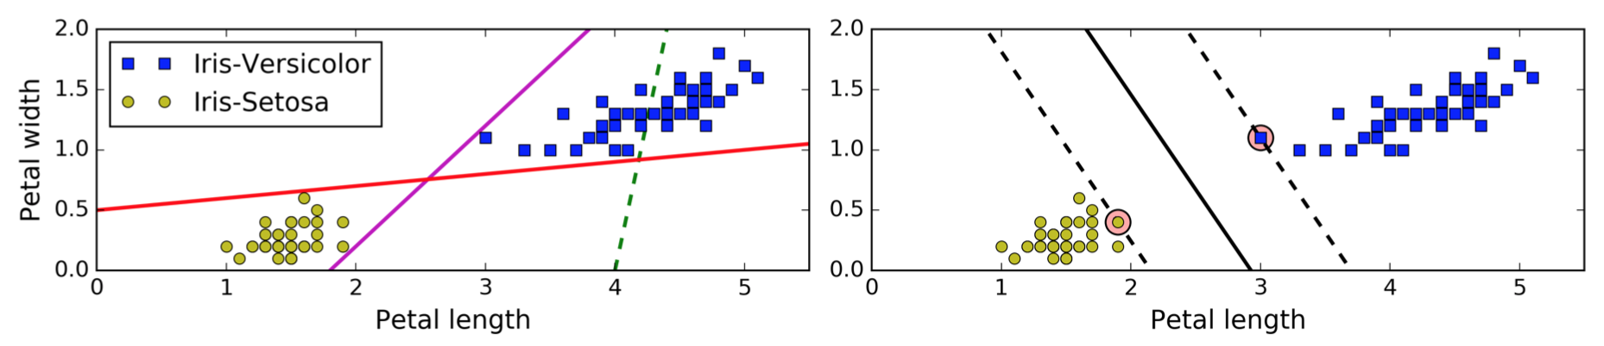
Linear SVM Classification
it is fully determined (or “supported”) by support vectors:
stays as far away from the closest training instances as possible - Large margin classification
SVMs are sensitive to the feature scales

Slide 48
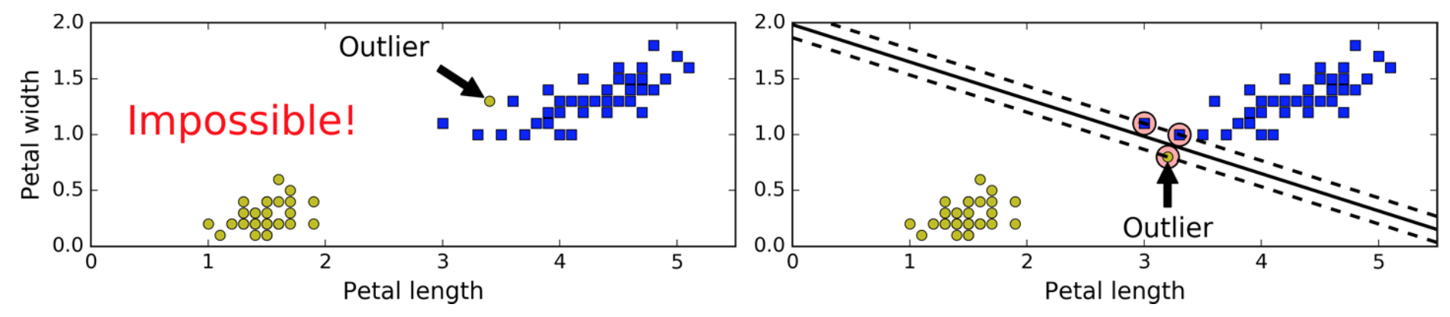
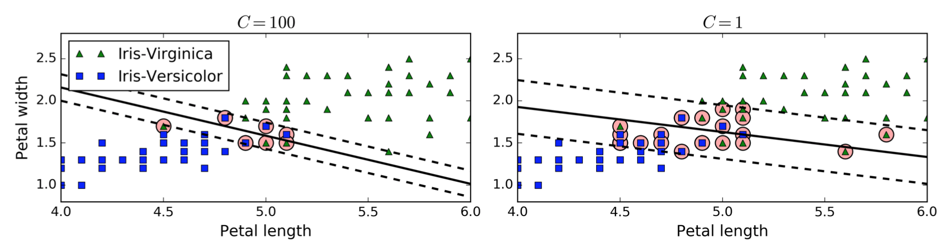
Soft Margin Classi cation
hard margin classification
keep the street as large as possible and limiting the margin violations

Slide 49
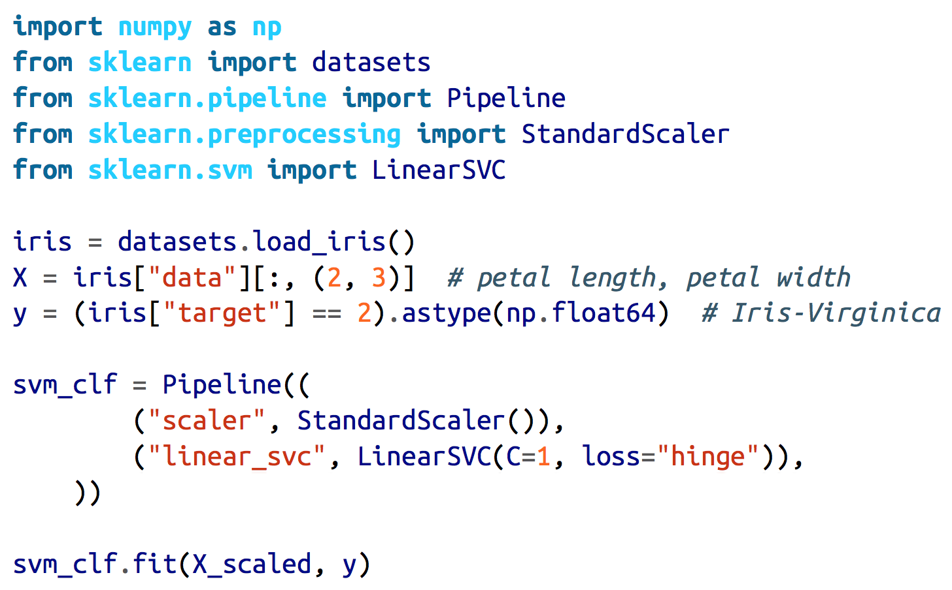
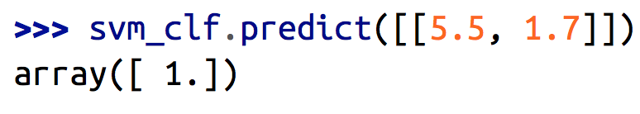

Slide 50
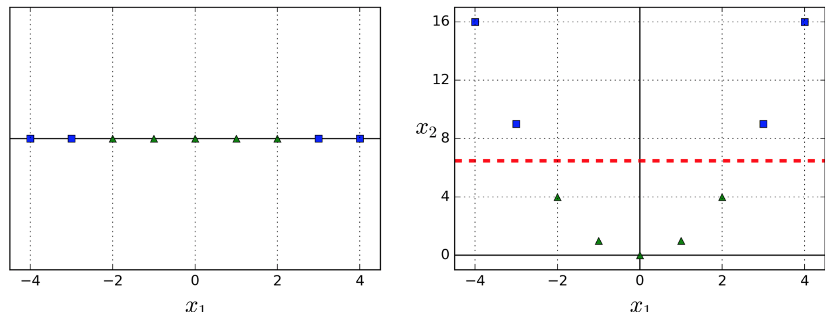
Nonlinear SVM Classi cation
many datasets are not even close to being linearly separable
One approach to handling nonlinear datasets is to add more features, such as polynomial features
if you add a second fea‐ ture x2 = (x1)2, the resulting 2D dataset is perfectly linearly separable

Slide 51
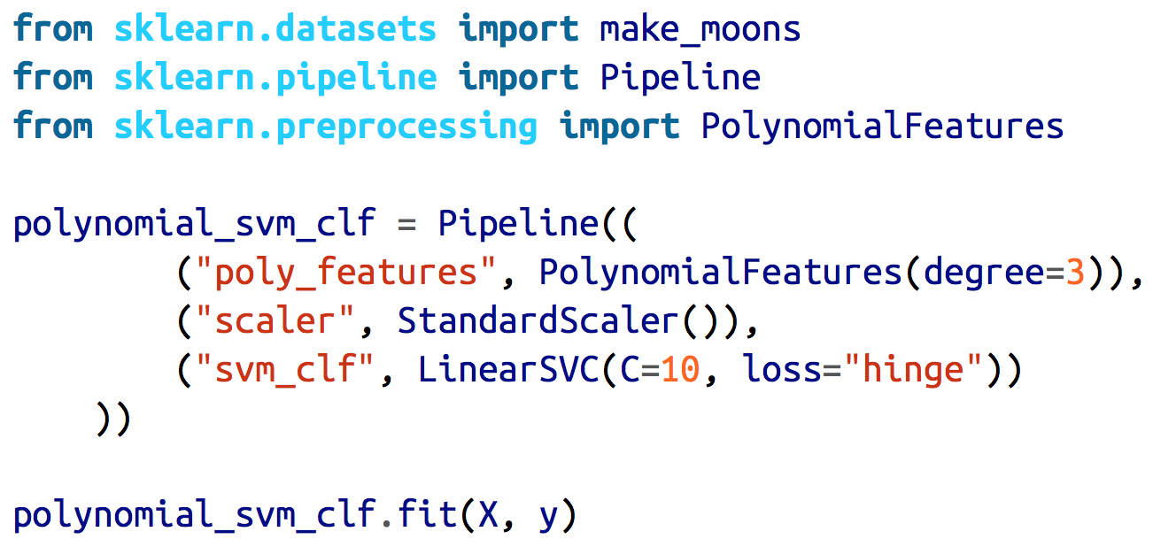
Pipeline

Slide 52
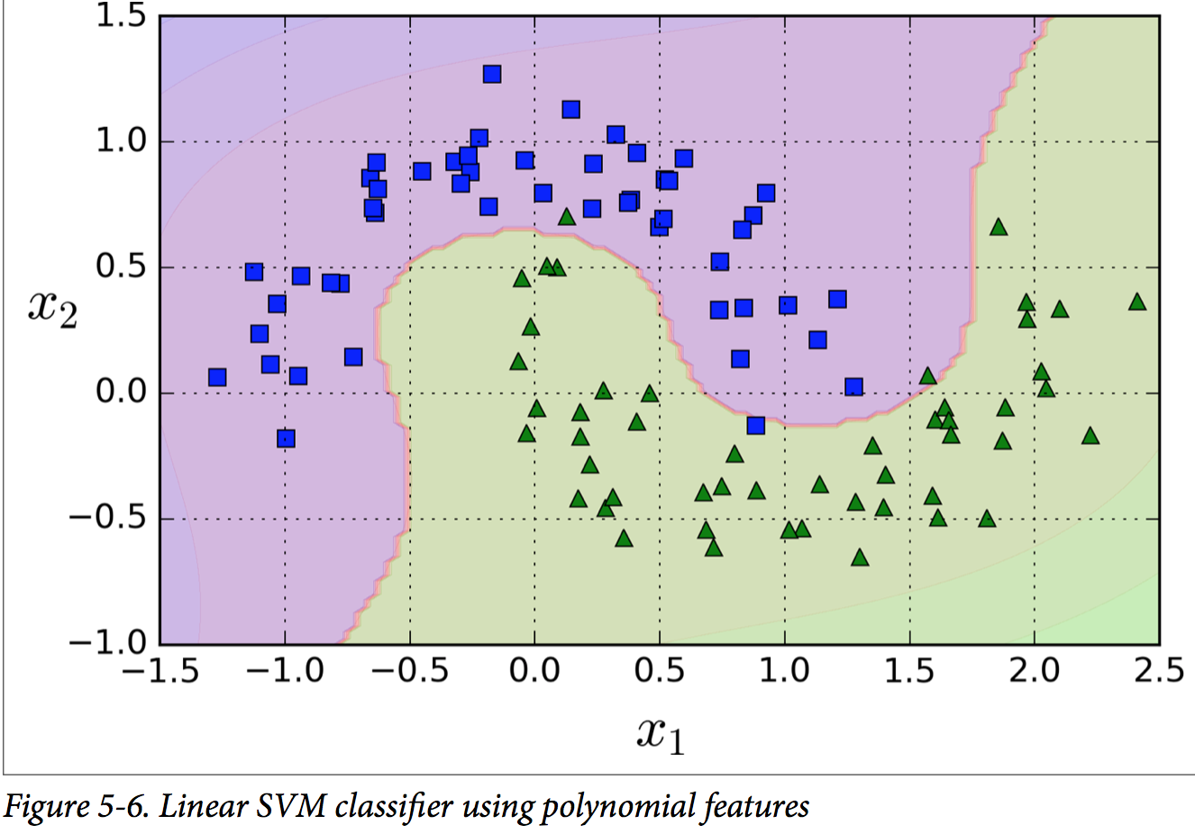

Slide 53
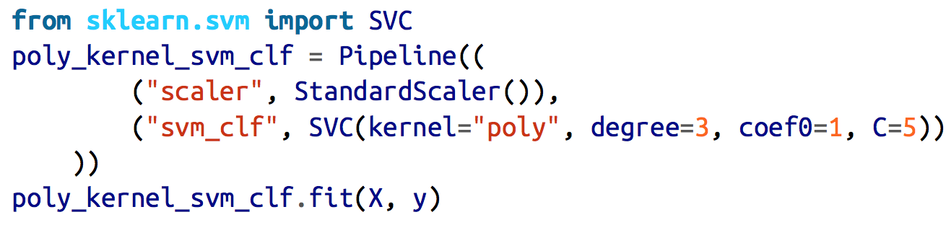
Polynomial Kernel
with a high polynomial degree it creates a huge number of features, making the model too slow
Fortunately, when using SVMs you can apply an almost miraculous mathematical technique called the kernel trick
get the same result without actually having to add them
coef0 controls how much the model is influenced by high- degree polynomials versus low-degree polynomials

Slide 54
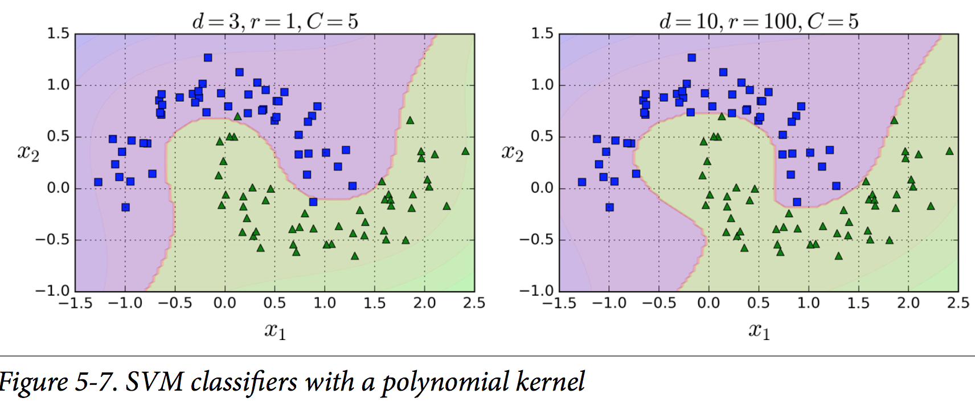

Slide 55
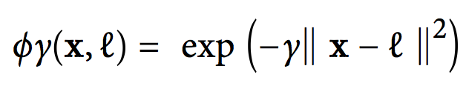

Adding Similarity Features
measures how much each instance resembles a particular landmark
define the similarity function to be the Gaussian Radial Basis Function (RBF)
the transformed dataset - now linearly separable !
create a landmark at the location of each and every instance in the dataset

Slide 56

Gaussian RBF Kernel
the kernel trick does its SVM magic: it makes it possible to obtain a similar result as if you had added many similarity features
γ acts like a regularization hyperparameter: if overfitting, you should reduce it, and if it is underfitting, you should increase it
similar to the C hyperparameter

Slide 57


Slide 58
Other kernels
String kernels : classifying text documents or DNA sequences
using the string subsequence kernel or kernels based on the Levenshtein distance
You should always try the linear kernel first
remember that LinearSVC is much faster than SVC(ker nel="linear")
especially if the training set is very large or if it has plenty of features
If the training set is not too large, you should try the Gaussian RBF kernel as well

Slide 59

SVM Regression

Slide 60
kernelized SVM model
To tackle nonlinear regression tasks, use a kernelized SVM model
SVMs can also be used for outlier detection

Slide 61

Decision Trees
can perform both classification (predection) and regression tasks, and multioutput tasks
capable of fitting complex datasets
fundamental components of Random Forests
they require very little data preparation
they don’t require feature scaling or centering at all.
gini attribute measures its impurity: a node is “pure” when gini=0

Slide 62


Slide 63

CART algorithm produces only binary trees
ID3 can produce more than two children.

Slide 64
White Box Versus Black Box
Decision Trees are fairly intuitive and their decisions are easy to inter‐ pret - called white box models
Random Forests or neural networks are - black box models
it is hard to know what actually contributed to a prediction

Slide 65

Estimating Class Probabilities
estimate the probability that an instance belongs to a particular class k

Slide 66

CART Training Algorithm
Scikit-Learn uses the Classi cation And Regression Tree (CART) algorithm
It searches for the pair (k, tk) that produces the purest subsets
feature k and a threshold tk
CART cost function for classication (weighted by their size)
a greedy algorithm - at the top level

Slide 67


Gini Impurity or Entropy ?
By default, the Gini impurity measure is used
The concept of entropy
originated in thermodynamics as a measure of molecular disorder,
and Shannon’s information theory - measures the average information content of a message
In Machine Learning, it is frequently used as an impurity measure
Gini is faster, entropy produces more balanced tree
A reduction of entropy is often called an information gain

Slide 68
Decision tree Regularization
Non parametric model
LR is a parametric model (can be underfitted due to the limited number of freedom)
Data need not to be linear
Can be overfitting – needs Regularization
Set max depth
min_samples_split - the minimum number of samples a node must have before it can be split
min_samples_leaf - the minimum number of samples a leaf node must have
min_weight_fraction_leaf (same as min_samples_leaf but expressed as a fraction of the total number of weighted instances)
max_leaf_nodes (maximum number of leaf nodes)
max_features (maximum number of features that are evaluated for splitting at each node)
Increasing min_* hyperparameters or reducing max_* hyperparameters will regularize the model

Slide 69


Slide 70

Regression with DT

Slide 71

the pre‐ dicted value for each region is always the average target value of the instances
split the training set in a way that minimizes the MSE

Slide 72


CART cost function for regression

Slide 73
Ensemble Learning and Random Forests
A group of predictors is called an ensemble
Ensemble Learning: aggregate the predictions of a group of predictors (such as classifiers or regressors), you will often get better predictions than with the best individual predictor
Random Forest
bagging, boosting, stacking

Slide 93

Limitations - instability
→ use PCA
they are very sensitive to small variations in the training data
since the training algorithm used by Scikit-Learn is stochastic you may get very different models even on the same training data

